Slide 1
Continuous Authorisation For Subject-centric Data Sharing

Slide 2
Structure of prestation
Introduction
Motivation
IOT based services for contextual information
Requirement analysis
Use case
Implementation
Conclusion
Questions answer

Slide 3
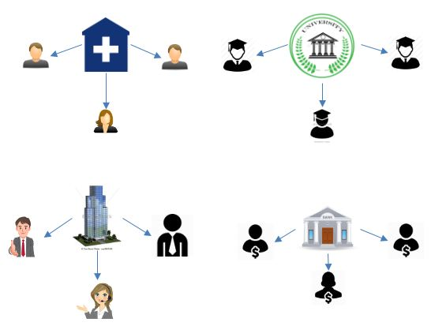
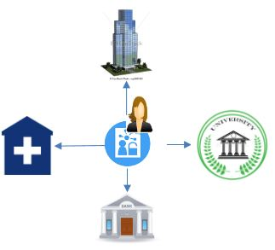
Subject Centric Data Sharing
Traditional System
Subject Centric system

Slide 4
Objectives of subject centric data sharing
In Subject-centric data sharing individuals want to achieve
Context – aware sharing
Privacy persevering sharing
Resharing of data
continuous authorization

Slide 5
Continuous authorisation
Attributes change from time to time
Authorisation decision is checked at a predefined interval
This is checkered by an authorisation manger
Only certain Attributes of the authorisation policy are checked

Slide 6
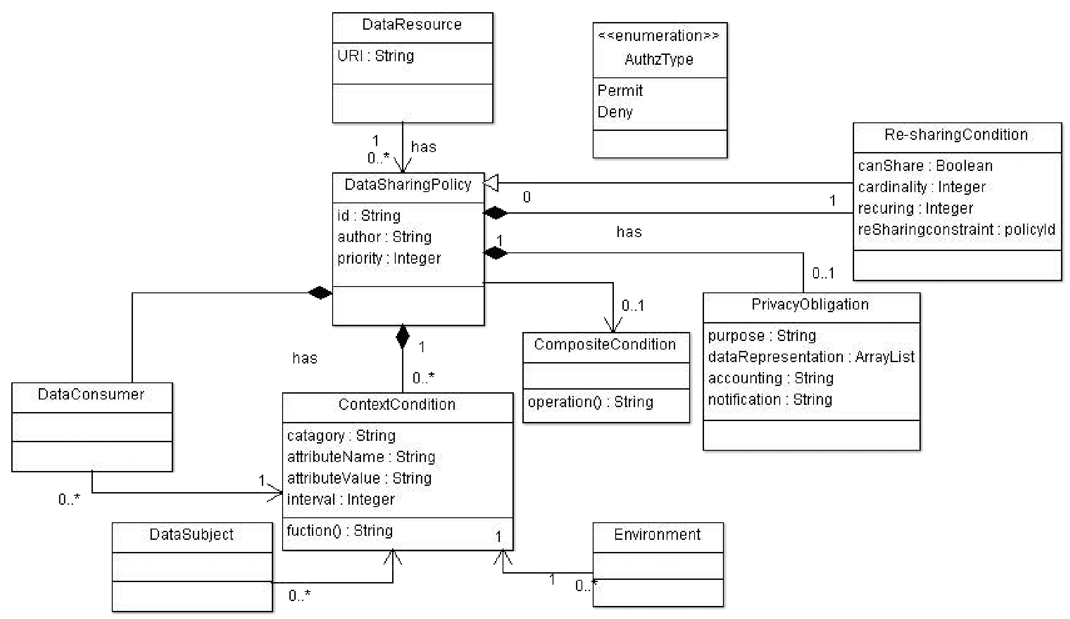
Continuous authorisation

Slide 7
Use Case
Location sharing with Ip camera

Slide 8
Use Case
Heart rate paramedics

Slide 9
Use Case
Sleep Video camera sharing

Slide 10
IOT based services for contextual information
Different IOT devices contains different kinds of sensors, which provided different kinds of contextual information
Such as
Location
Heart rate
Light sensor
Blood pressure
Temperature
Different IOT devices may have the same sensors but different data representation

Slide 11
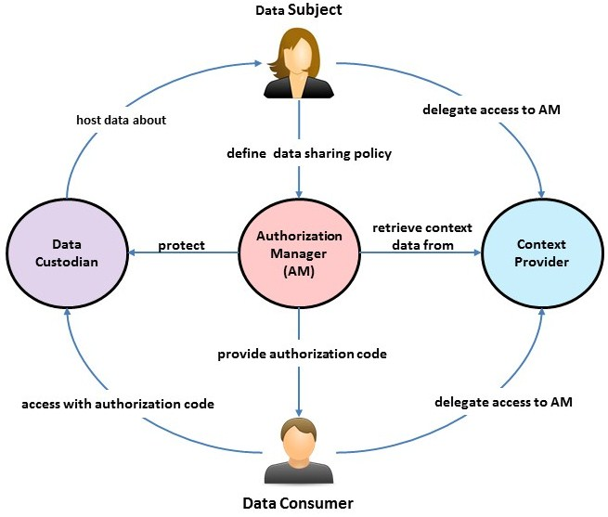
Implementation
Comprised of serval programs
Policies
Attempted to recreate two use cases
Sharing an academic transcript with an employer (static data)
Sharing an Ip camera feed when the data subject is not home (live data)
Benchmarking

Slide 12
Implementation - Programs
Authorisation manger
prototype context provider library
Rest API Server
policy creation web page
Benchmarking application
Example data custodians pages
Static data resource example page
Contunisus data resource example page
Companion applications
Android application
Tizen OS application

Slide 13
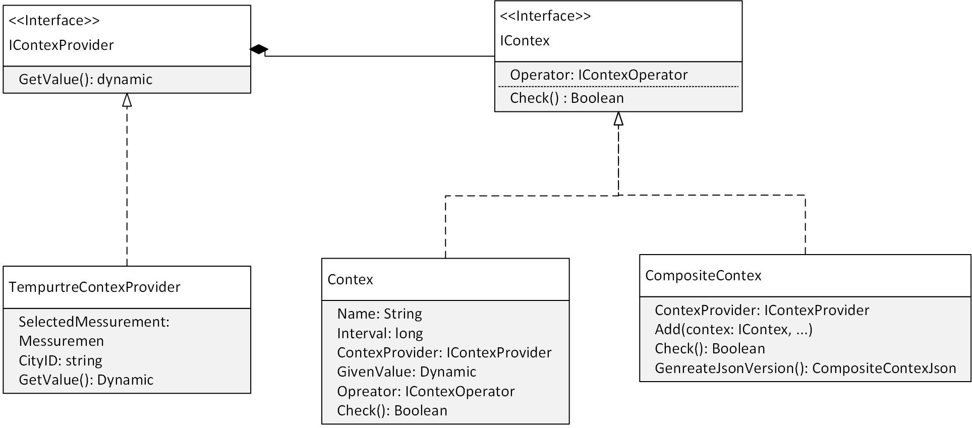
Implementation - Polices
Polices are implemented as C# classes
These classes can be serialised and deserialised by the newtonsoft Jsonconvertion library
Utilises Context providers
Stuchute listed to the right
Example policy next slide

Slide 14
Example Policy
{
"Id": 2403263712767113334,
"Author": "notpaul",
"Proity": 0,
"Interval": 0,
"Decision": "garbage",
"DataConsumer": { "Name": "paul", "Value": "pfsarda23@gmail.com" },
"JsonCompositeContex": {
"Conteiexs": [
{
"Contex": {
"Name": "TempTest",
"Interval": 0,
"ContextProvider": {
"$type": “…",
"CityID": "6952201",
"SelectedMessurement": 1
},
"GivenValue": 0,
"IContexOperator": {"$type": “…"}
},
"Glue": 0,
"Not": false
}
]
},
"PrivacyOblgations": { "Purpose": "garbage", "Granularity": "garbage", "Anonymisation": "garbage", "Notifaction": "garbage", "Accounting": "garbage“ },
"ResharingObligations": { "CanShare": true, "Cardinality": 10, "Recurring": 10 }
}

Slide 15
Implementation – Demonstration
Video recoding of demo

Slide 16
Implementation - Benchmark
Ran two tests
Already loaded in and serialised policy
Unloaded and not serialised
Each test would evaluate the policy 10, 100, 1000, 10000 times each
Four polices with Zero context providers one, two, three

Slide 17
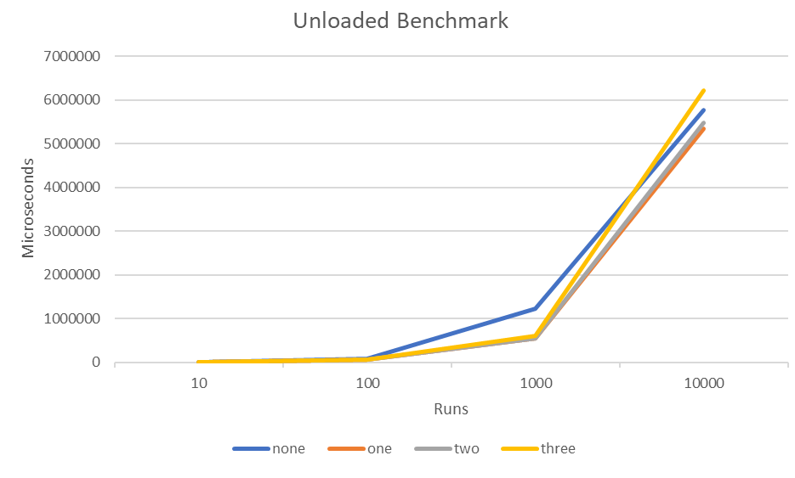
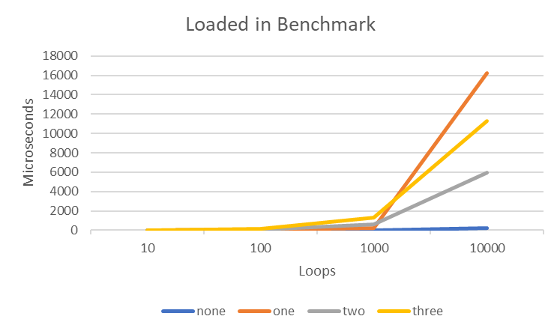
Implementation – Benchmark

Slide 18
Limitations
Implementation related
Only a single AM exists in our system but was design so the URL could be changed
Conunteus checking is completed on client side live data version need to be created
Tokens do not expire

Slide 19
Related work

Slide 20
Conclusion

Slide 21
Thank you for your time
Questions?

